Slide 1
Comp 271 Final Project
SpellComplete

Slide 2
What it does?
The SpellComplete can
Take a paragraph of user input and tell you if you misspelled certains word or not
Give you recommendations to help improve your spellings
Based on Lexicographical similarity
Based on Word Popularities
Autocomplete your sentence by giving you sensible completed word recommendations
Look up a word in the dictionary to see if it is a valid English word or not
Compare performance of different dictionaries based on different data structures
Use a stack to store user input and retrieve previously entered searches using an “undo button”

Slide 3
Program Architecture
Dictionary (Interface)
Dictionary Interface Implemented by Dictionary Classes below
Array Clss
LinkedList Class
Unbalanced BST Class (extends BinaryTree Class)
Balanced BST Class
HashMap Class
Trie Class (Includes AutoComplete Method)
Spelling Suggestions (NearbyWords Class)
Spelling Suggestions
(FreqWords)
App (Main)
TrieNode
Dictionary Loader (Loads data)
ArrayStack Class (For Copy Paste Operation)

Slide 4
SpellChecker
Looks up words in a dictionary using different data structures.
Each word is individually checked in the string to see if it exists by searching through the dictionary for its value. If a value is not found to be equal to the string then, this word is added to a list of misspelled words and returned to the user
The program implements the following dictionaries:
Array (both traversel and binary search)
LinkedList
Binary Search Tree (unbalanced)
Balanced Binary Search Tree (from a sorted Array)
HashMap
Trie

Slide 5
AutoComplete Dictionary
Uses a trie data structure to search for words. Instead of storing words in the nodes like in a binary tree, a Trie simply stores all individual 26 english letters as nodes at each level
Each level can have up to 26 nodes (one for each english alphabet)
Each Letter Node has a pointer to 26 different child nodes (alphabets)
To Add a Node, each letter of the word to be added is traversed individually down the tree, looking for that letter, then on to the next until either the word is complete or we hit a null node—which is where we add the child

Slide 6
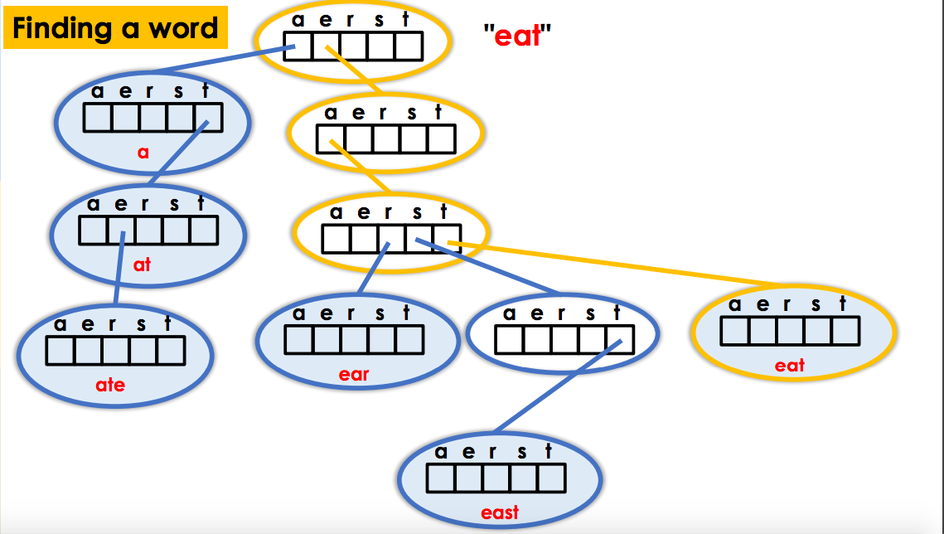
Traversing a node
Credit: Coursera and UC San Diego

Slide 7
The AutoComplete Algorithm
Find the incomplete stem by traversing through the trie until the partially completed word is found in the trie
Once you find a stem then traverse the tree below the stem using Breadth First Search
For each child node you look at below the stem, add its data value to a list of EnglishWords if it is a valid word. Then add its children to a Queue so they can be looked at next.
Keep doing until you run out of words or have enough words to return, return the EnglishWord List
This is possible because tries take advantage of shared word structure so every word below a child has the parent as its prefix

Slide 8
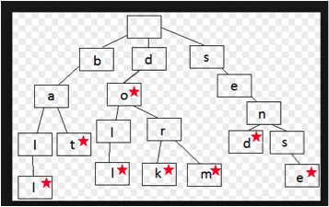
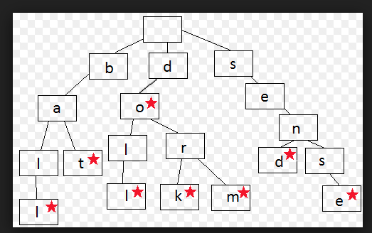
AutoComplete
Let’s suppose we want to autocomplete “do”
First we traverse the tree until we reach “do”
Then we use breadth first search to look for words below do
We start with dol node…it is not a word so we ignore, add its children to the queue and move to “dor” also not a word. So we add its children.
We then take from the Queue the first item (dol’s child “doll”)
Doll is a word so we add it to our WordList which will be returned

Slide 9
Spelling Suggestions Algorithm
Generates all possible combination of words that can be derived from the string using the “one letter away” mutation idea
Substution: replacing an exisitng word in the string with another alphabet
Insertion: adding an alphabet at all possible locations in the string
Deletions: removing an existing letter from the String
Once all possible combinations are generated, then all child words are added to a Queue
Words that are valid English Words are added to a separate Word List
Then this process is repeated using a Queue and BreadthFirstSearch where the first child String generated above is popped and then it is used to generate mutations
Repeat, until either the queue is empty or enough valid words have been generated

Slide 10
Spelling Suggestions Algorithm - Returning Words
Once all words are generated then the valid words are returned either using:
Lexicograpahical similarity - valid words generated first from parent string are also shown first (direct mutations of the string itself are higher priority than valid english mutations of the children or grandchildren)
Word Frequency - Instead of String similarity, Word popularity is determined as the criteria to return.
English words are stored as new FreqWord object instances with a string and rank variable each
Objects that are more frequent (like “and”, “the” ) with higher ranks are pushed to the front of the line using a PriorityQueue (where an Overriden Comparator compares using their Word Frequency Rank in the english language...not the value of the string itself)

